Slide 1
ECONOMETRICS DATA ASSIGNMENT
(Analysis of the relationship between Groundwater Level and Power Inequalities across the districts in India)
BY - RAJ CHOUDHARY
AHMED HANOON RAMIT GUPTA ARCHIT GARG

Slide 2
BACKGROUND
Groundwater levels have been declining rapidly in the country owing to various natural and social factors, which have major repercussions for the environment and the livelihood of the populace. Groundwater is a slowly replenishing natural resource that demands an in-depth study for its conservation.
Studying groundwater levels can provide critical information for various stakeholders, including water resource managers, farmers, urban planners, and policymakers. It can help them make informed decisions on water use, identify areas of overuse or contamination, and develop effective management strategies.

Slide 3
LINEAR REGRESSION MODEL
This is the output of a simple linear regression model that examines the relationship between two variables in the my_merged_file_final dataset. The response variable is Ground.water.level.mean and the predictor variable is value. The summary provides information about the residuals, coefficients, and goodness of fit statistics of the model.
The intercept estimate of the model is 7.670e+00 and the slope estimate for value is 2.502e-06. The p-value for the slope coefficient is less than 0.001, indicating that there is a statistically significant relationship between the predictor and response variables. However, the adjusted R-squared value of 0.007515 indicates that only a small proportion of the variability in Ground.water.level.mean is explained by value. Therefore, while there is a significant linear relationship between these variables, the strength of the relationship is weak.
The stargazer() function is used to create a summary table of the linear regression model simple_linear_reg_model and export it to a text file named simple_linear_reg_model.txt.
The table shows the coefficients of the model, the standard errors of the coefficients, and the statistical significance of the coefficients based on their p-values. The model has a dependent variable of Ground.water.level.mean and an independent variable of value. The coefficient estimate for the independent variable is significant at the 0.01 level, indicating that there is a positive relationship between value and Ground.water.level.mean. The constant term is also significant at the 0.01 level, indicating that there is a non-zero intercept. The R-squared value of the model is very low at 0.008, suggesting that the model explains only a small portion of the variation in the dependent variable. The adjusted R-squared value is also very low at 0.008. Finally, the F-statistic of the model is statistically significant at the 0.01 level, indicating that at least one of the coefficients is non-zero.

Slide 4
OBSERVATIONS
Variable used | Value | Interpretation
max_ground_water_level | 160.0933 | The output max_ground_water_level = 160.0933 is the maximum value of the Ground.water.level.mean variable in the my_merged_file_final dataframe.The summarize() function is used to calculate summary statistics for a dataset, in this case, the maximum value of the Ground.water.level.mean variable. The max() function is used to calculate the maximum value of Ground.water.level.mean variable.The na.rm = TRUE argument is used to remove any missing values in the Ground.water.level.mean variable before calculating the maximum value.
min_ground_water_level | 0.01879192 | Same as max_ground_water_level
Skewness my_merged_file_final$value | 1.183005 | A skewness of 1.183005 for the 'value' variable suggests that the distribution of values is positively skewed, meaning that there are more low values and a few high values.
Skewness my_merged_file_final$Gini | 0.7351024 | A skewness of 0.7351024 for the 'Gini' variable indicates that the distribution of Gini values is moderately positively skewed, meaning that there are more low Gini values and a few high values.
Skewness my_merged_file_final$Ground.water.level.mean | 6.585678 | A skewness of 6.585678 for the 'Ground.water.level.mean' variable indicates that the distribution of ground water level is highly positively skewed, meaning that there are a few extremely high values and most of the values are concentrated towards the lower end. This skewness value is quite high and may indicate the presence of outliers or extreme values in the dataset.

Slide 5
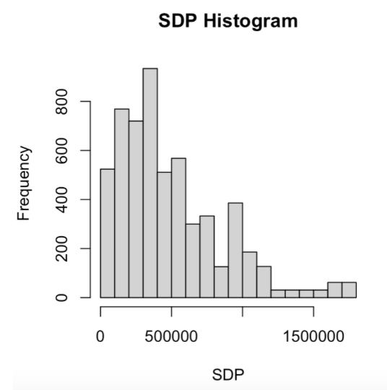
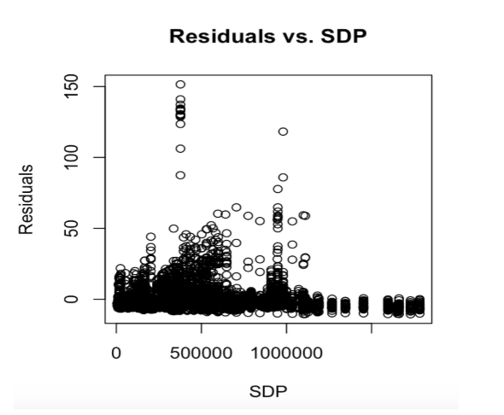
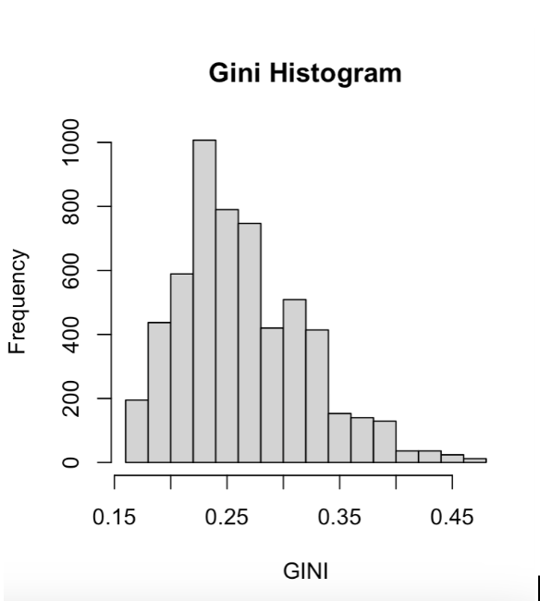
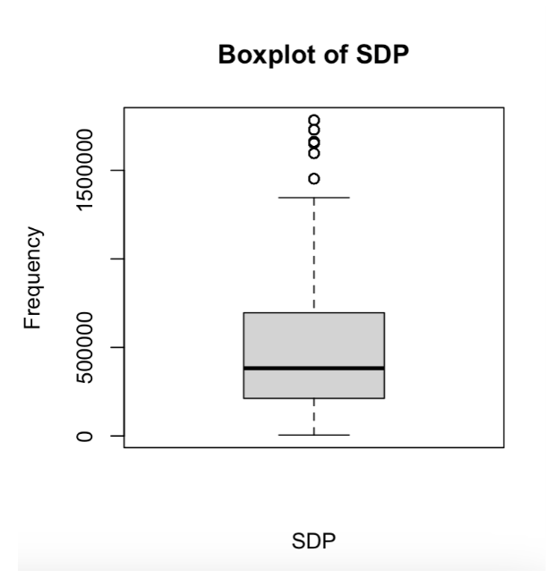
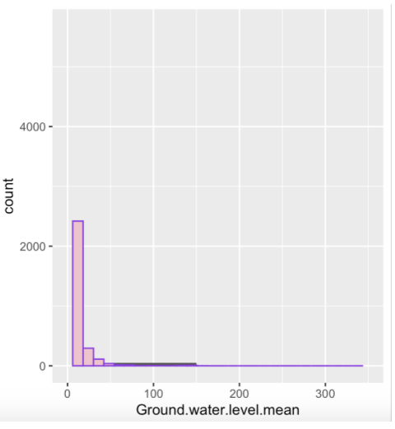
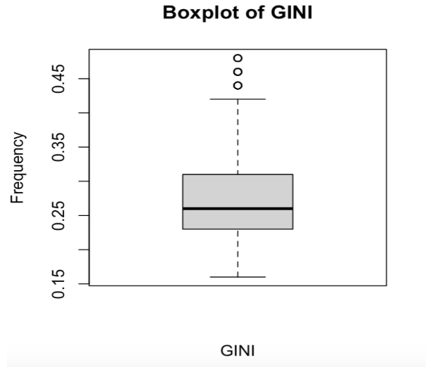

Slide 6
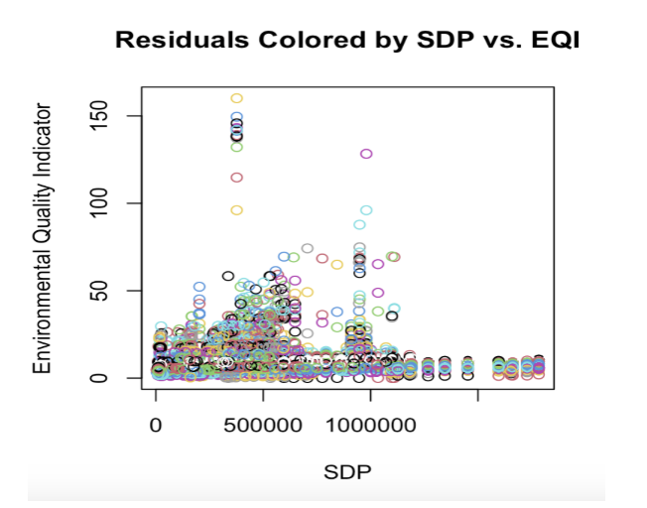
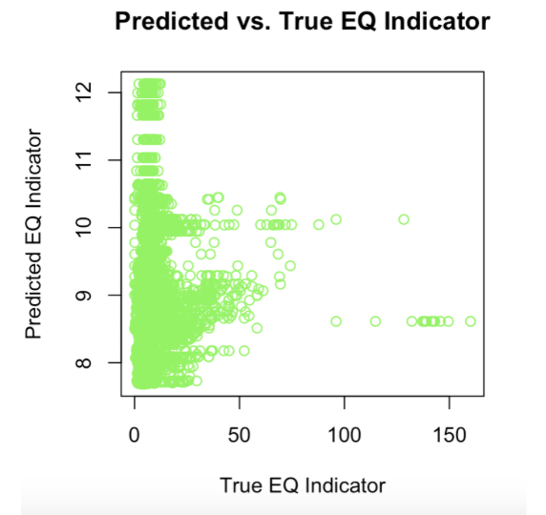
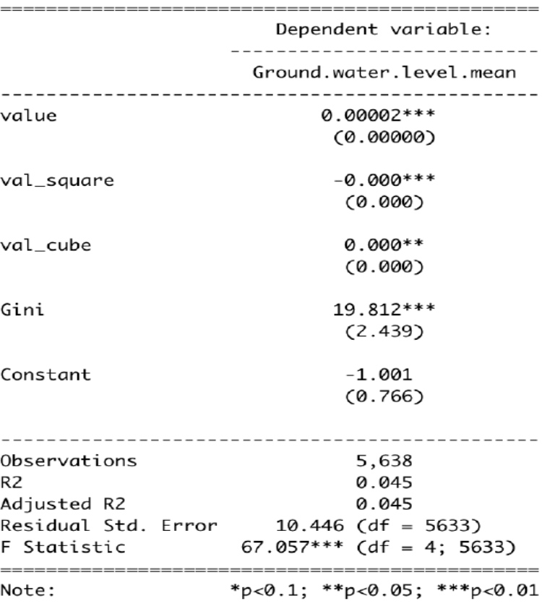
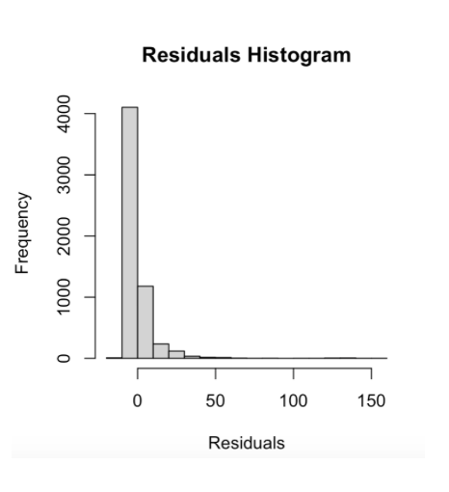
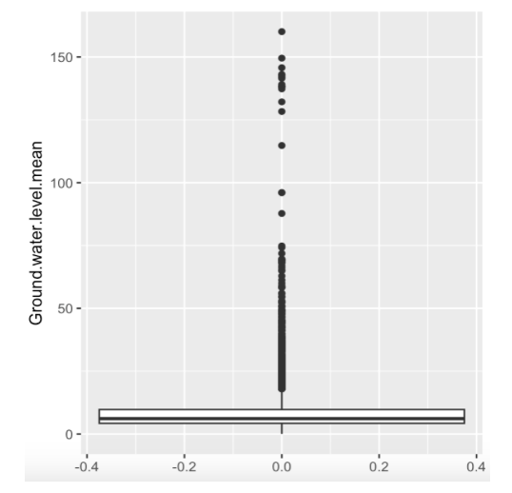

Slide 7
MONTE CARLO
The code is performing Monte Carlo simulation to estimate the slope and intercept coefficients of a linear regression model between the dependent variable Ground.water.level and the independent variable value. The slope and intercept coefficients are estimated using the ordinary least squares (OLS) method for multiple iterations.
In particular, the code sets a seed for reproducibility, generates n=1000 observations for the independent variable X_i from a normal distribution with mean 5 and standard deviation 5, generates the error term U_i from a normal distribution with mean 0 and standard deviation 2, and computes the dependent variable Y_i using the true values of the slope alpha_1 = -2.567e-06 and intercept alpha_0 = 7.872 along with the independent variable and the error term. This process is repeated M = 550 times.
For each iteration, the code fits a linear regression model using the feols function from the fixest package and extracts the estimated slope and intercept coefficients. These coefficients are stored in vectors slope1 and intercept1, respectively.
Finally, the code creates a data.table estimates1 that contains the estimated values of the slope and intercept coefficients from all the iterations, and prints a summary of these estimates using the stargazer function.

Slide 8
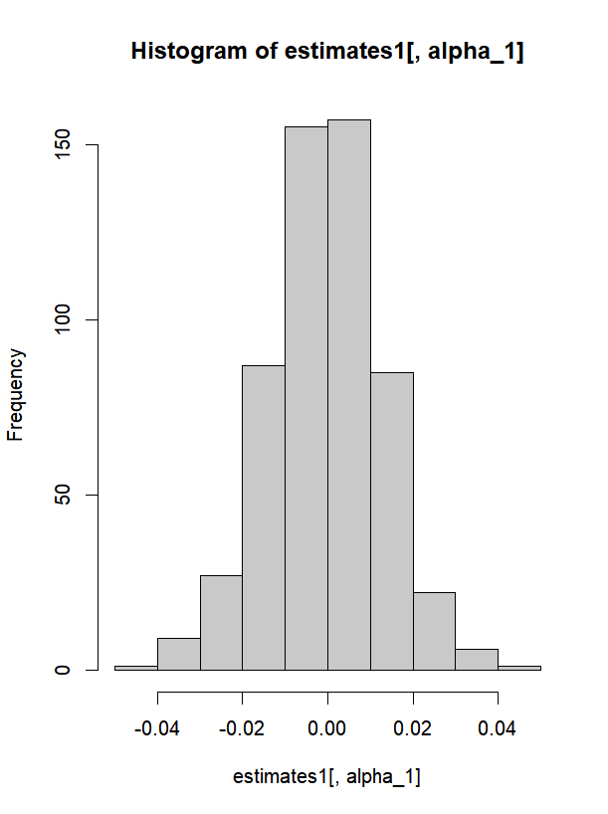
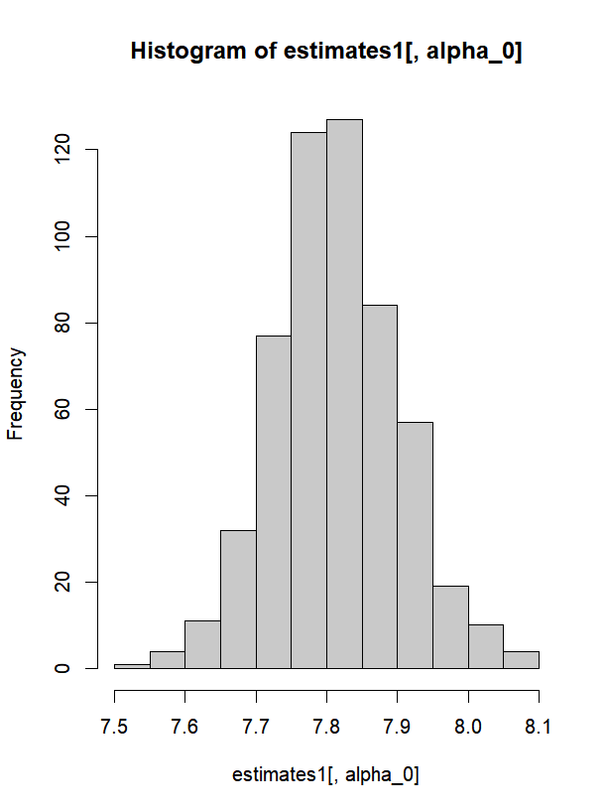

Slide 9
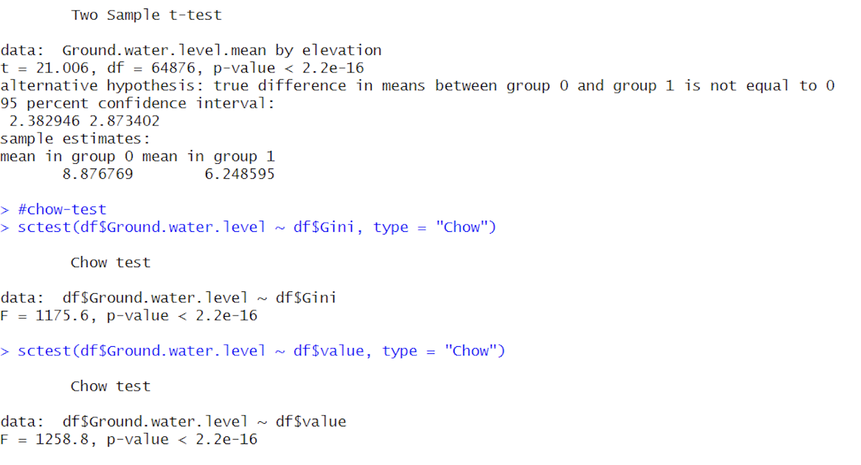
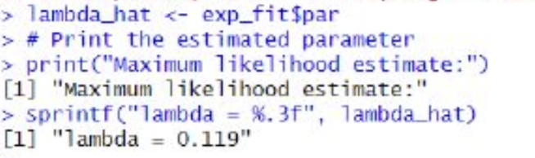
T-TEST AND CHOW TEST
MAXIMUM LIKELIHOOD ESTIMATION
By running the Chow test we can see that the p-value is less than 0.05. From this we reject the null at 5% significance level and say that there is structural break in the mean environmental quality across different state-groups. Running t-test also implies the same.
We used MLE with two underlying distributions. The results are as seen MLE helps in enhancing our model because it is asymptotically normal, efficient and invariant. It is also a consistent estimator. If we know the underlying distribution of our data we can take care of missing data that's usually a problem with OLS.

Slide 10
CONCLUSION
The following variables were found to have a statistically insignificant effect on groundwater level:
The intercept: The groundwater level does not have a fixed value when all other variables are zero.
Margin of election victory: Electoral outcomes do not have a significant impact on groundwater levels.
Number of factories: Industrial activities may not have a significant impact on groundwater levels.
Overall, these results suggest that policies aimed at promoting economic growth and reducing wealth inequality, along with measures to ensure political stability and sustainability of agricultural practices, may help improve groundwater management.
The following variables were found to have a statistically significant effect on groundwater level:
State Domestic Product (SDP): SDP has an exponential effect on groundwater level. As the SDP increases, the groundwater level also increases, but the relationship is not linear and exhibits a parabolic shape.
Wealth Distribution: A negative relationship exists between wealth inequality, as measured by the Gini coefficient, and groundwater level.
Effective number of parties: The political stability and consensus-building among different political groups may positively impact groundwater levels.

Slide 11
THANK YOU!
REFERENCES
GAURAV ARORA
SUMEDHA SHUKLA
https://www.statisticshowto.com/chow-test/
https://vitalflux.com/linear-regression-t-test-formula-example/#:~:text=t%20is%20the%20t%2Dtest,The%20value%20of%20m0%20%3D%200
https://www.thoughtco.com/kuznets-curve-in-economics-1146122
https://databank.worldbank.org/metadataglossary/gender-statistics/series/SI.POV.GINI
https://ndap.niti.gov.in/dataset/6796
https://ndap.niti.gov.in/dataset/7379
https://ndap.niti.gov.in/dataset/7147?tab=profile
https://rbidocs.rbi.org.in/rdocs/Publications/PDFs/STATEMENTS27EEB6471170F8493D9C1C88E1468AC8F5.PDF

